Slide 1
ATAI
Advanced Techniqueof Artificial Intelligence
ATAI
ChongqingUniversity _{AdvancedTechniqueof}
of Technology Artificial Intelligence
Chongqing University of
Technology
Chongqing University ^{ATAI}
_{of Technology} Advanced Techniqueof
Artificial Intelligence
Chongqing University of Technology
Chongqing University of Technology
LGMRec: Local and Global Graph Learning for
Multimodal Recommendation
Code: https://github.com/georgeguo-cn/LGMRec
2024.2.22 •ChongQing
—— AAAI 2024
Reported by Ling Tan
1

Slide 2
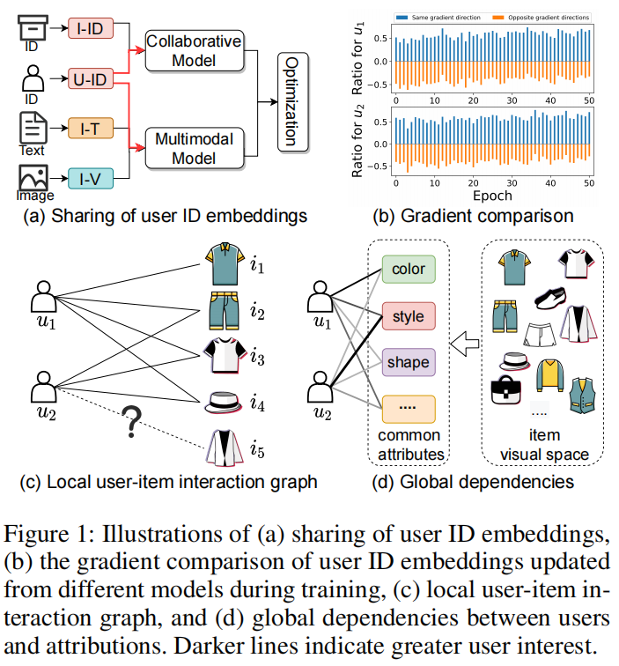
ATAI
AdvancedTechniqueof
Artificial Intelligence
ATAI
ChongqingUniversity _{AdvancedTechniqueof}
of Technology Artificial Intelligence
ChongqingUniversity of Technology
Motivation
（1） Coupling. Firstly, collaboration and multimodal information provide different avenues for exploring user interests. In general, collaborative signals emphasize similar user behavior patterns, while modal knowledge is reflected through content similarity.
（2）Locality. Secondly, most existing methods only learn local user interests from the interaction graph (Figure1 (c)), lacking the exploration of user global interests.

Slide 3
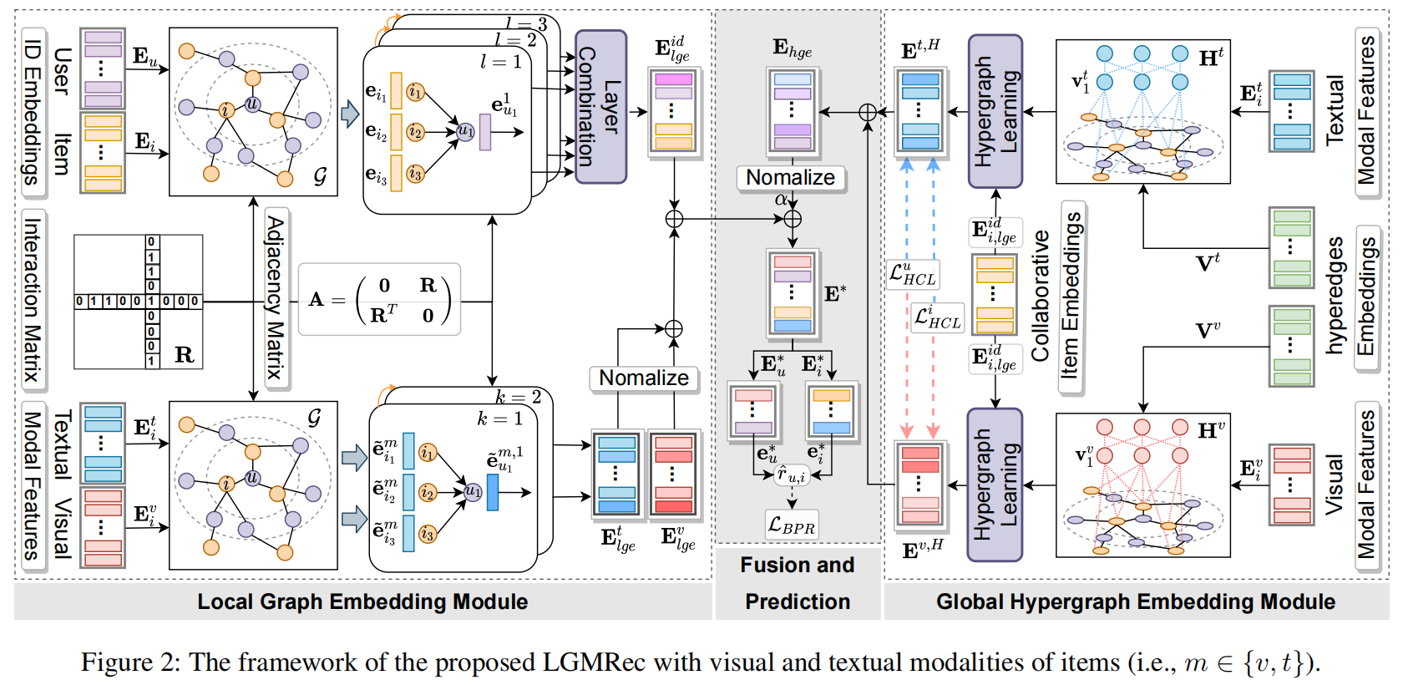
ChongqingUniversity of Technology
ATAI
AdvancedTechniqueof
Artificial Intelligence
ATAI
ChongqingUniversity _{AdvancedTechniqueof}
of Technology Artificial Intelligence
Overview

Slide 4
ChongqingUniversity of Technology
ATAI
AdvancedTechniqueof
Artificial Intelligence
ATAI
ChongqingUniversity _{AdvancedTechniqueof}
of Technology Artificial Intelligence
Method
Problem Statement

Slide 5
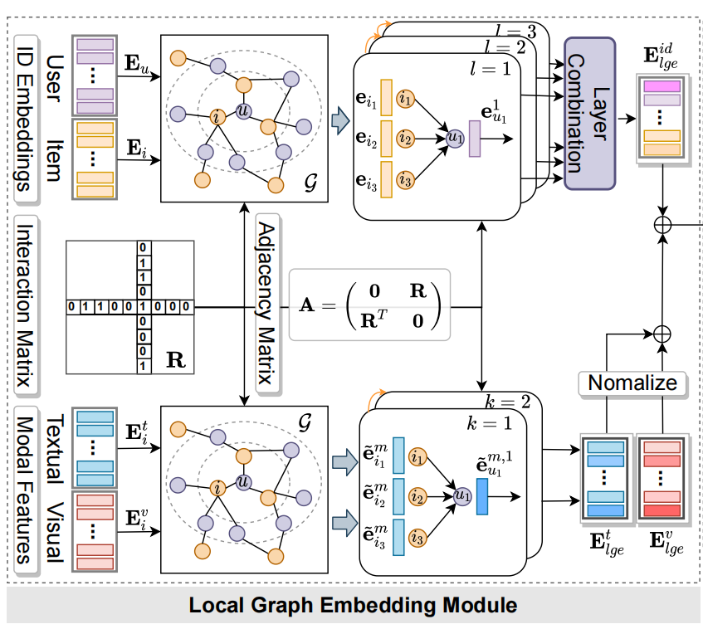
ChongqingUniversity of Technology
ATAI
AdvancedTechniqueof
Artificial Intelligence
ATAI
ChongqingUniversity _{AdvancedTechniqueof}
of Technology Artificial Intelligence
Method

Slide 6
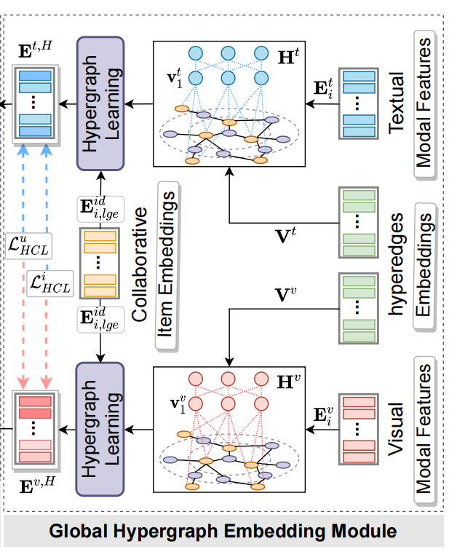
ChongqingUniversity of Technology
ATAI
AdvancedTechniqueof
Artificial Intelligence
ATAI
ChongqingUniversity _{AdvancedTechniqueof}
of Technology Artificial Intelligence
Method

Slide 7
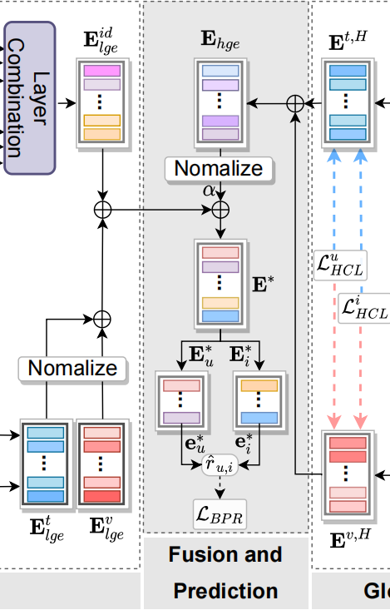
ChongqingUniversity of Technology
ATAI
AdvancedTechniqueof
Artificial Intelligence
ATAI
ChongqingUniversity _{AdvancedTechniqueof}
of Technology Artificial Intelligence
Method

Slide 8
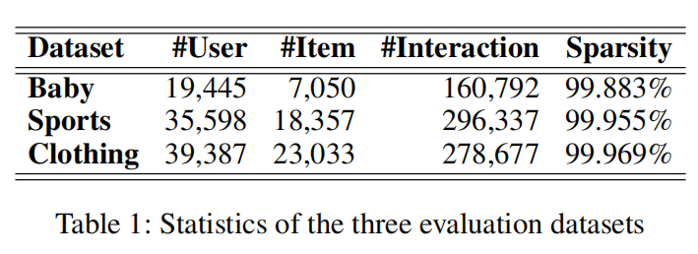
ATAI
AdvancedTechniqueof
Artificial Intelligence
ATAI
ChongqingUniversity _{AdvancedTechniqueof}
of Technology Artificial Intelligence
ChongqingUniversity of Technology
Experiments

Slide 9
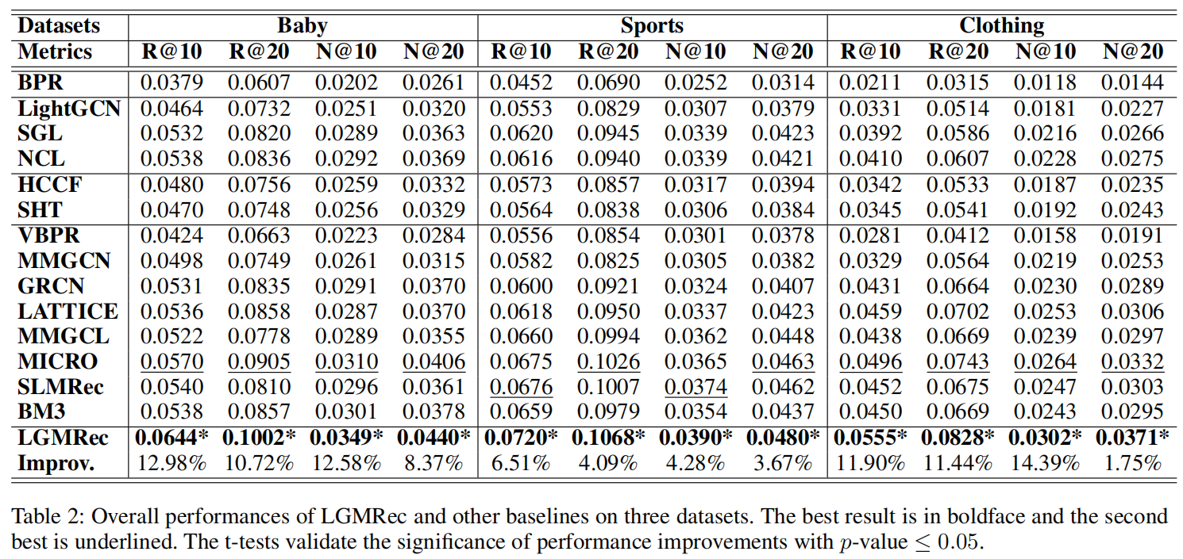
ATAI
AdvancedTechniqueof
Artificial Intelligence
ATAI
ChongqingUniversity _{AdvancedTechniqueof}
of Technology Artificial Intelligence
ChongqingUniversity of Technology
Experiments

Slide 10
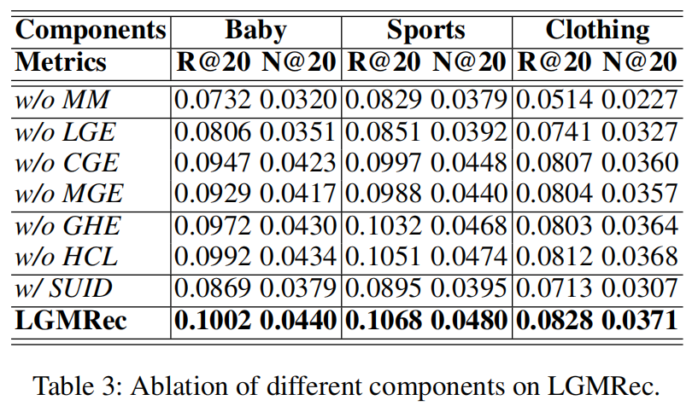
ATAI
AdvancedTechniqueof
Artificial Intelligence
ATAI
ChongqingUniversity _{AdvancedTechniqueof}
of Technology Artificial Intelligence
ChongqingUniversity of Technology
Experiments

Slide 11
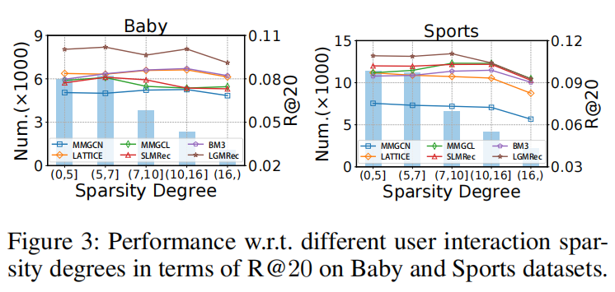
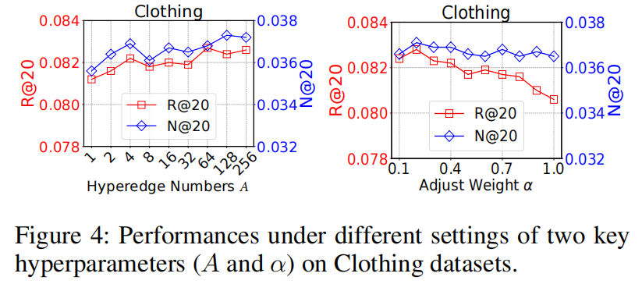
ATAI
AdvancedTechniqueof
Artificial Intelligence
ATAI
ChongqingUniversity _{AdvancedTechniqueof}
of Technology Artificial Intelligence
ChongqingUniversity of Technology
Experiments

Slide 12
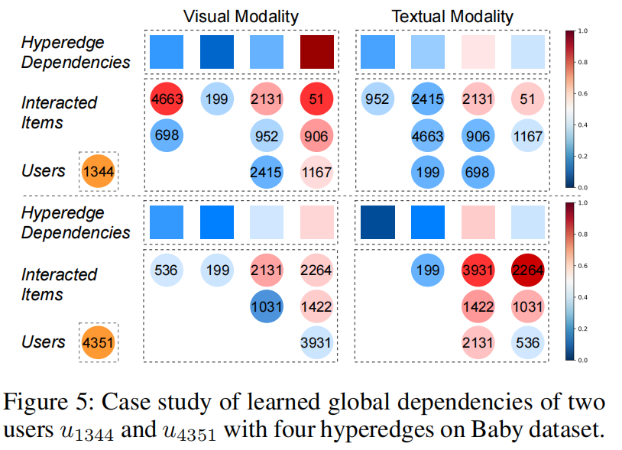
ATAI
AdvancedTechniqueof
Artificial Intelligence
ATAI
ChongqingUniversity _{AdvancedTechniqueof}
of Technology Artificial Intelligence
ChongqingUniversity of Technology
Experiments

Slide 13
ChongqingUniversity of Technology
ATAI
AdvancedTechniqueof
Artificial Intelligence
ATAI
ChongqingUniversity _{AdvancedTechniqueof}
of Technology Artificial Intelligence
Thanks!

